Slide 1
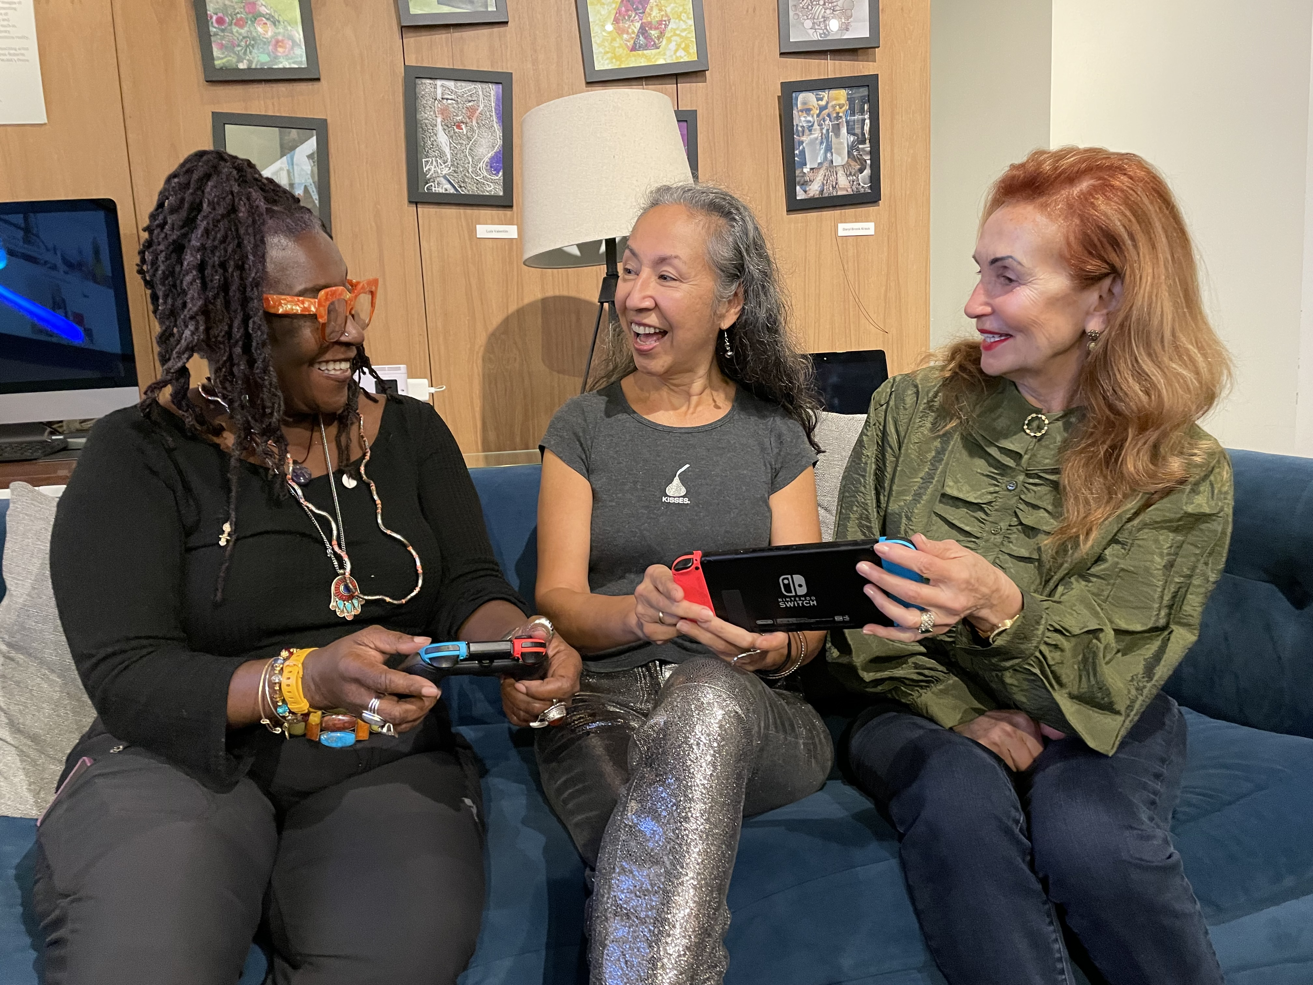

Intro to Senior Planet
www.seniorplanet.org
Notes:
Hello! I’m excited today to tell you about Senior Planet from AARP.

Slide 2
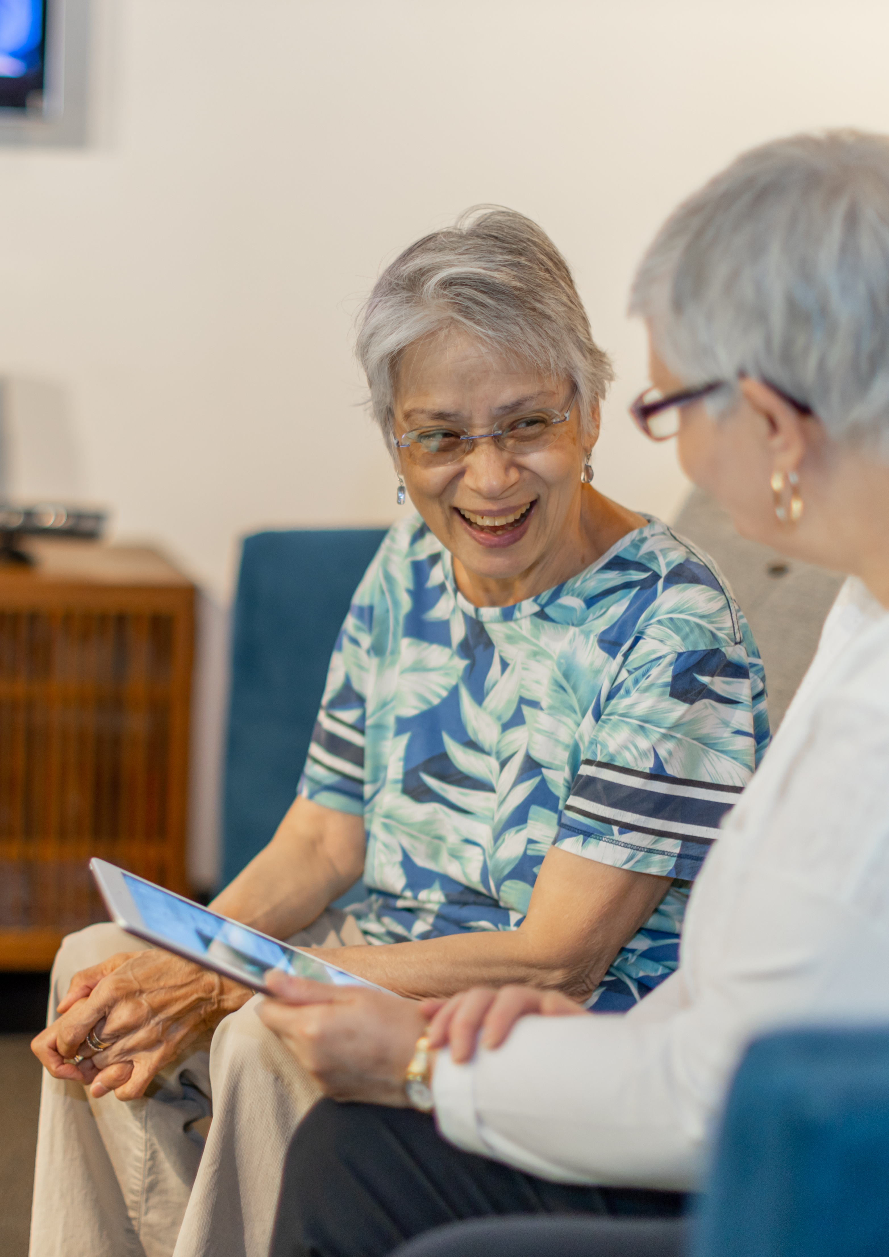
What is Senior Planet?
A community for older adults where they can learn, work, create, exercise, and thrive in today’s digital age (both in-person and online!)
Senior Planet offers free classes and programs that are designed for people aged 50+
Our motto is "Aging with Attitude!"
www.seniorplanet.org
Notes:
Senior Planet’s purpose is to help older adults come together and find ways to learn, work, create, exercise, and thrive in today’s digital age. Our motto is "Aging with Attitude."

Slide 3
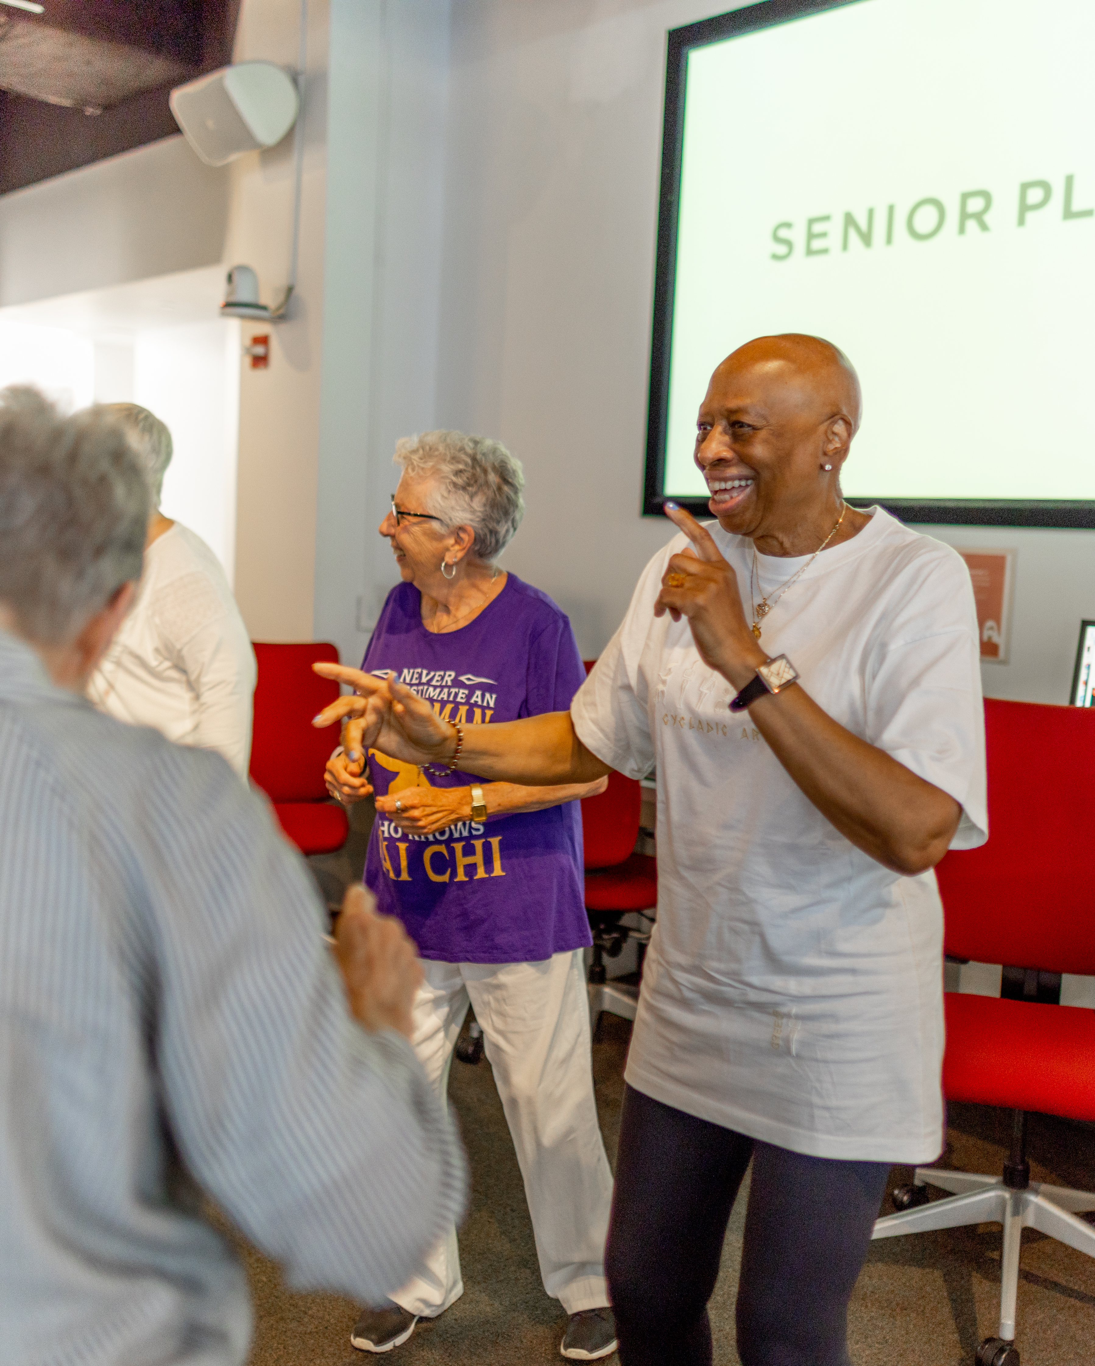
Programs
Senior Planet offers both online and in-person...
Tech Workshops and Lectures
Fitness Classes
Health and Wellness Programs
Discussion Groups
Computer Basics, Exercise Classes, Social Media, Smartphone Photography, Travel, Healthy Aging, AI, Meditation, Book Club, Discussion Group for LGBT Seniors, and so much more!
English, Spanish, Mandarin, Vietnamese
Example Topics Covered:
Languages:
Notes:
Senior Planet offers a wide range of free programs.
Some examples of topics covered: Computer Basics, Social Media, Smartphone Photography, AI, morning stretch, meditation, a book club, a pride discussion group for LGBT seniors, and so much more!

Slide 4
Where to Participate:
Since going virtual during the COVID19 pandemic, most Senior Planet offerings are held ONLINE!
We also have in-person classes available in...
New York City
North Country, New York
Denver, Colorado
Miami, Florida
Montgomery County, Maryland
San Antonio, Texas
Additionally, we have 400+ partner sites around the U.S. that teach our programs, you can find them at https://seniorplanet.org/licensing
www.seniorplanet.org
Notes:
Senior Planet’s purpose is to help older adults come together and find ways to learn, work, create, exercise, and thrive in today’s digital age. Our motto is "Aging with Attitude."

Slide 5

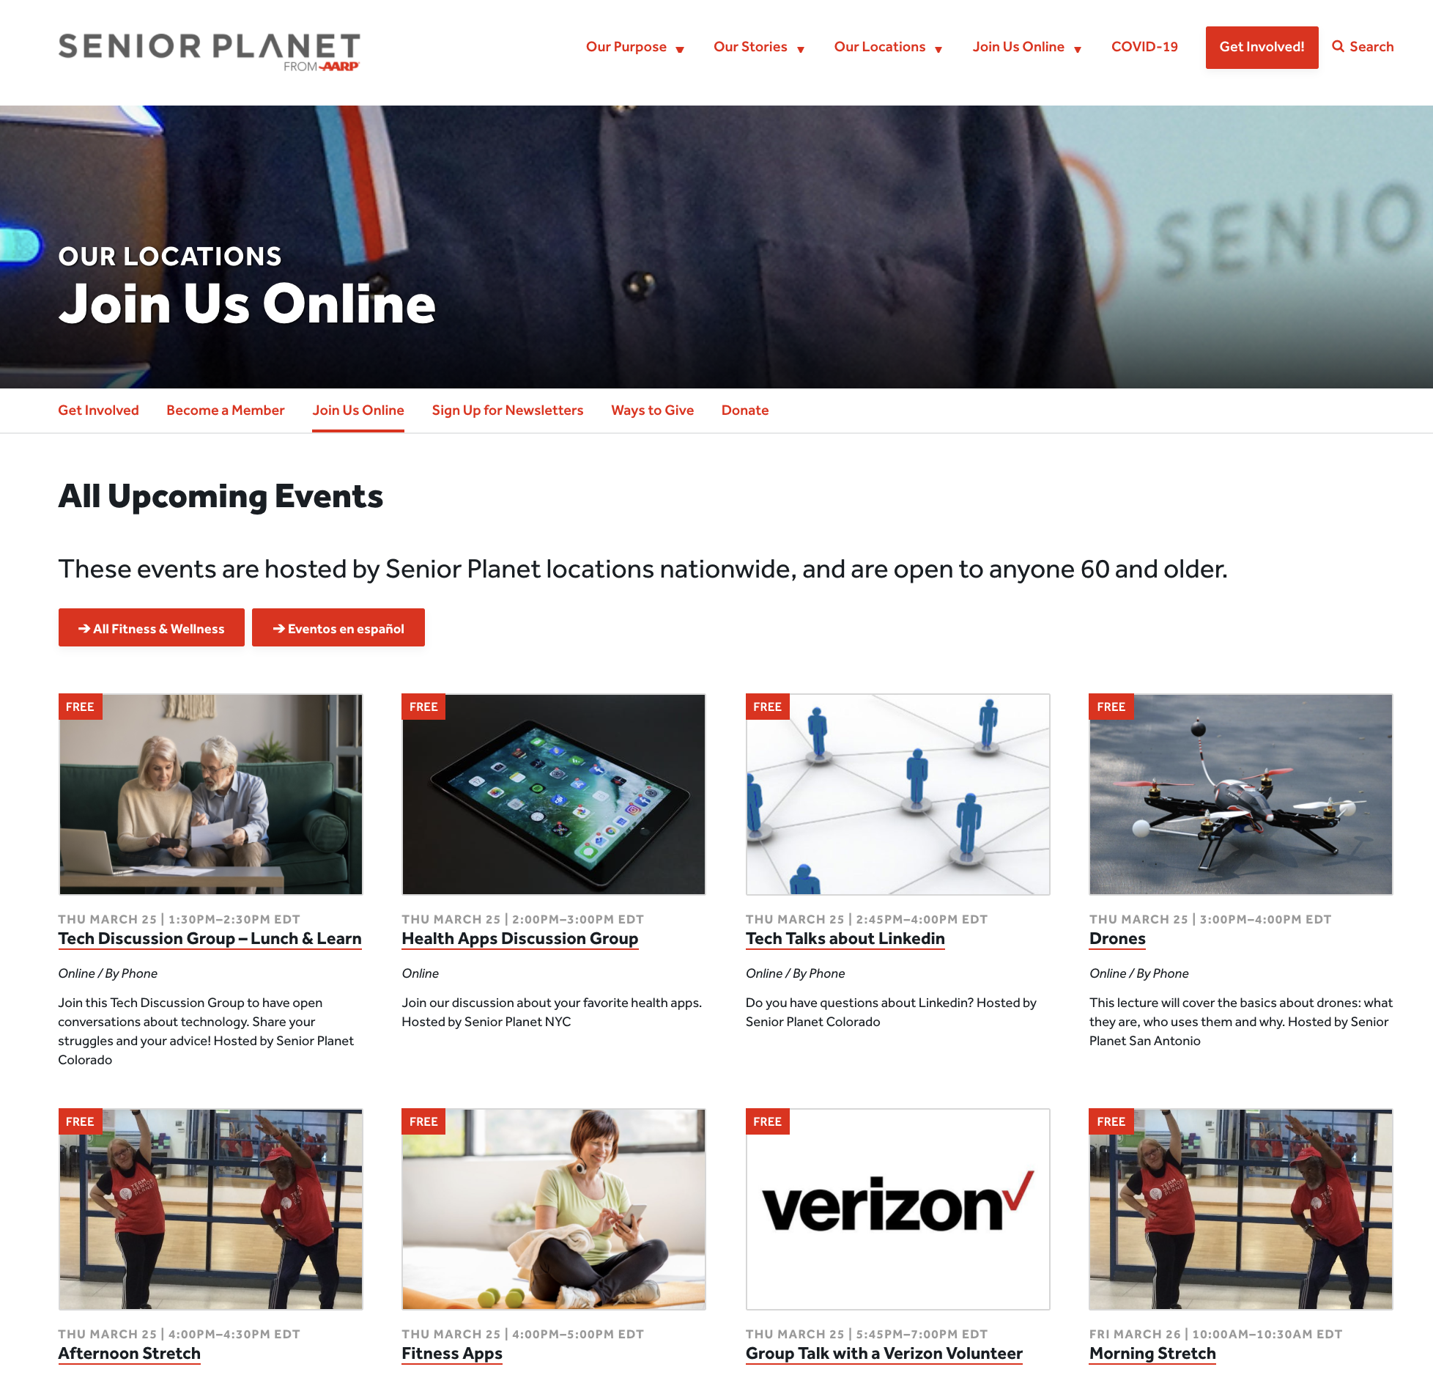
For more information: SeniorPlanet.org
Schedule of live online and in-person classes
Explore 24/7 online resources (YouTube videos, tutorials, etc.)
Read original articles
Sign up for newsletters
Learn about volunteer opportunities

Slide 6
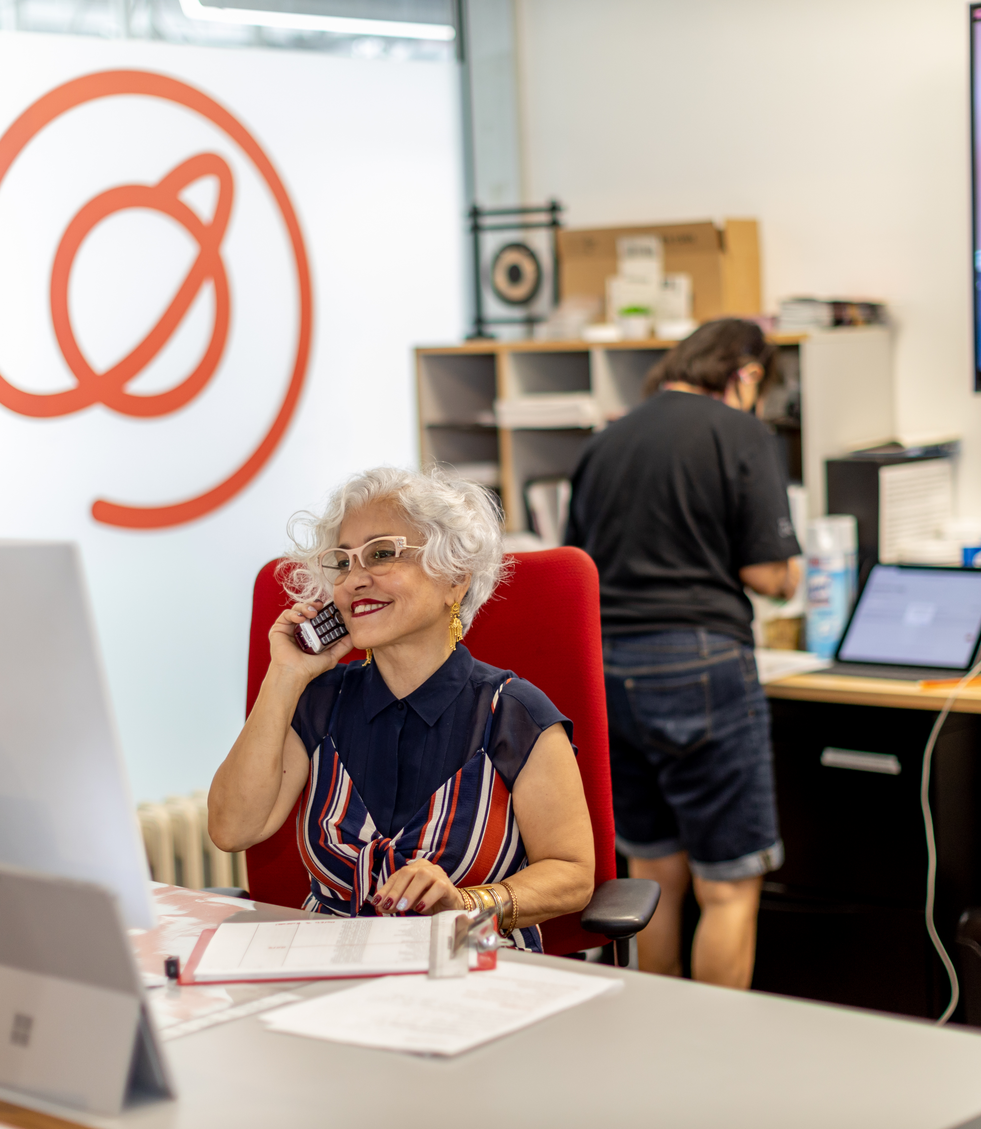
Hotline Support
Senior Planet's FREE hotline connects you with patient agents who can answer questions like how to use Zoom, set up an email account, download an app and more!
You can also learn about Senior Planet's many programs and resources.
(888) 713 – 3495
Monday – Friday: 9:00 AM – 8:00 PM ET
Saturday: 9:00 AM - 2:00 PM ET

Slide 7
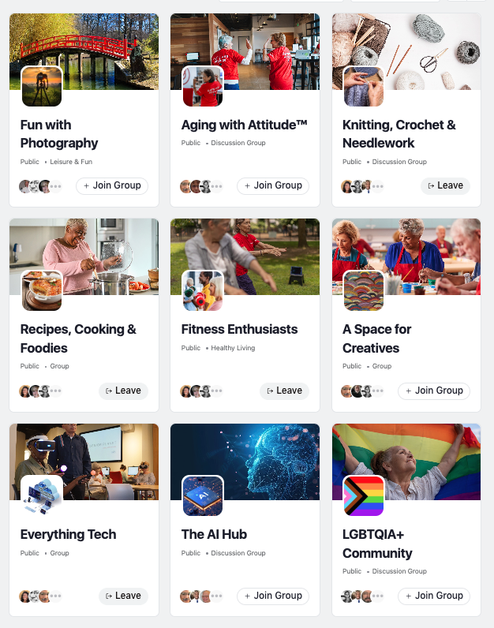
Senior Planet Community
In 2021, Senior Planet launched a free social media platform designed for and by older adults.
Highlights of the platform include:
Interest-based groups
User-generated, moderated content
Ad-Free
Sign up at community.seniorplanet.org
Notes:
Learn mo

Slide 8
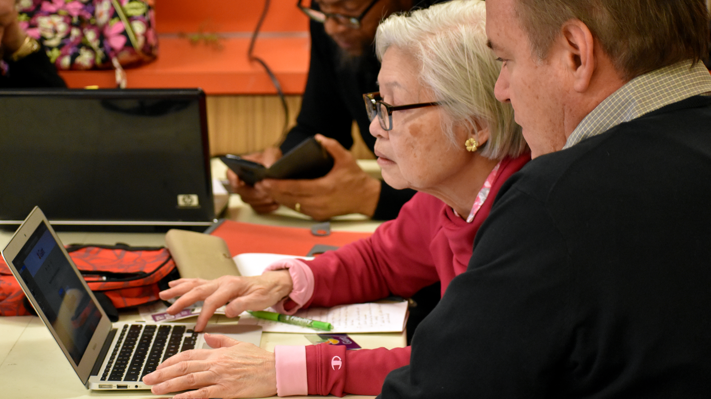


Questions?
www.seniorplanet.org
888-713-3495

